Slide 1
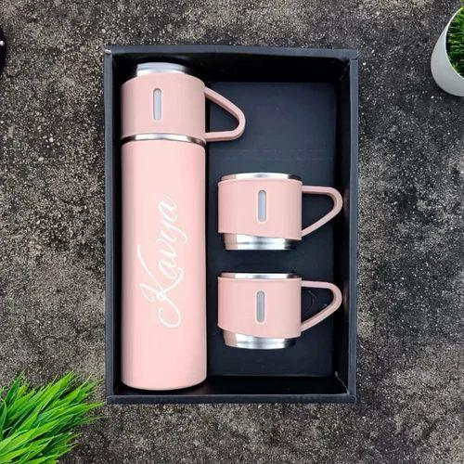
HANIVIK METALS
Plastic bottles are non-biodegradable which make them harmful for the Environment. Stainless Steel bottles is Eco-friendly.

Slide 2
PRODUCTS
Plain Water Bottles
Bottles are made up with Stainless Steel. It is Hygienic and Odourless. Rounded corners are easy to clean with no hard angles where dirt, germs or bacteria can stick. Ideal for keeping yourself hydrated all day long. Easy to sip and pour.
Printed Water Bottles
This smart water bottle is personalized with your picture and text. Perfect gift for anyone on their birthday, anniversary or any other occasion - for kids, adults. It features some of the best artistic designs which serves both as home décor and utility items.
Brass God Statue
A beautifully sculpted idol of god Statues made from pure brass for home temple or religious showpiece. Sculpture are symbolic of peace, solace & divinity in every place. A great gifting idea for traditional or religious Hindu occasion.

Slide 3
PLATFORM
Hanivik metals website was devloped by IndiaMART platform.

Slide 4
Website Responsiveness
These six pages are responsiveness design and optimized mobile
https://www.hanivikmetals.com/
https://www.hanivikmetals.com/water-bottle.html
https://www.hanivikmetals.com/brass-god-statue.html
https://www.hanivikmetals.com/plain-water-bottles.html
https://www.hanivikmetals.com/printed-water-bottles.html
https://www.hanivikmetals.com/stainless-steel-dinner-plate.html

Slide 5
Website Design Mistakes
There is no logo on this company's website . A logo is important for the growth of a company and for distinguishing its products.
This company's website does not contain any content referring to that item.
The design of this website is not attractive. Add more high quality picture and content of your product.
There is no proper arrangement in home page. Rearrangement of menu, company location and details and product category.
GST No is not necessary to mention in website.
Theme of web site is more important. A palette of fonts style and colors of theme throughout the website should be same.

Slide 6
List Of Best Practices For Creating Visuals
Logo is most important one for every web site.
Explain your business or product in short description.
Add some slogan or thoughts related to your business.
Highlight your any proved movement or event.
Add contact information prominently.
A size of font and colour of theme should be unique.
Add clear images and video of your product .
Add text below image or video.
Improve page speed.
Add video review.

Slide 7
Landing Page
https://hanivik.zoholandingpage.in/First-Landing-Page

